Slide 1

AMOS
Be Just
Dr. Rick Griffith • Crossroads International Church Singapore
BibleStudyDownloads.org

Slide 2
Key Word
583
343
Injustice
Amos
Notes:
Today we address the issue of injustice.

Slide 3
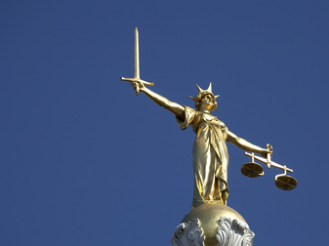
Discussion Group Question
How would you define social justice?
Notes:
Too often we want God to be merciful to us but just to others. We don't want him to be just with us and merciful to those who commit injustice! The idea is that everyone else deserves God's justice and no one deserves his mercy—except me!

Slide 4
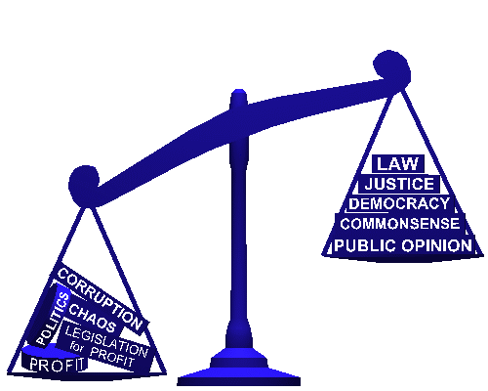
What About You?
How have you personally experienced injustice?
LAW
JUSTICE
DEMOCRACY
COMMON SENSE
PUBLIC OPINION
CORRUPTION
CHAOS
POLITICS
LEGISLATION FOR PROFIT
PROFIT
Notes:
When have you been paid unfairly?
What opportunities have unjustly been withheld from you?
How have you been taken advantage of?

Slide 5
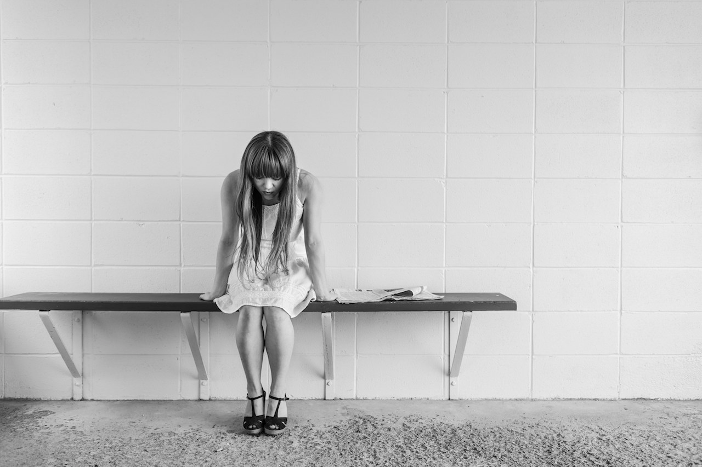
How does God respond to injustice?
Does He care?
Notes:
What has he done and what will he do about prejudice?

Slide 6
Key Verse
583
"But let justice roll on like a river, righteousness like a never-failing stream"
(Amos 5:24).
Amos

Slide 7
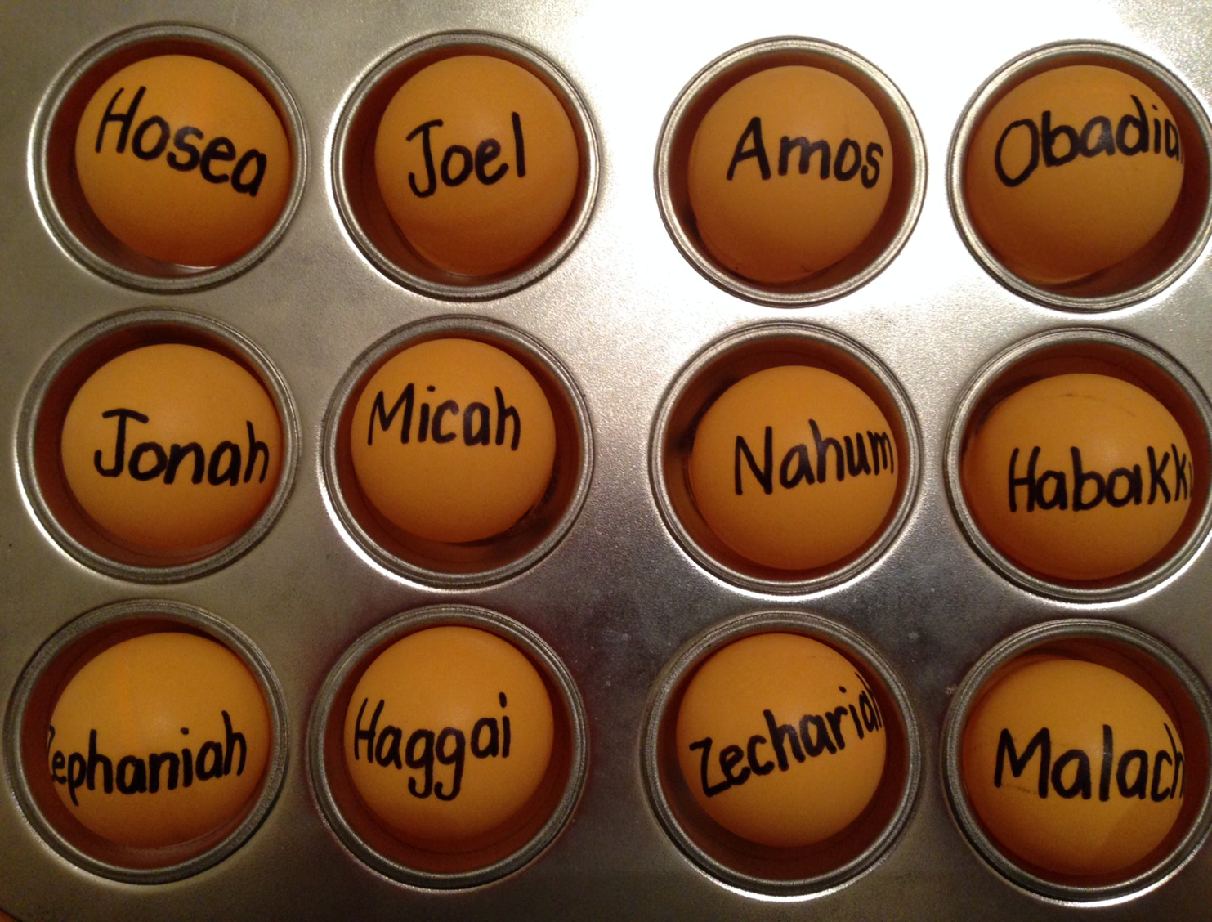
The Twelve
Courage to Confront Culture
—A Preaching Series on the Minor Prophets—

Slide 8
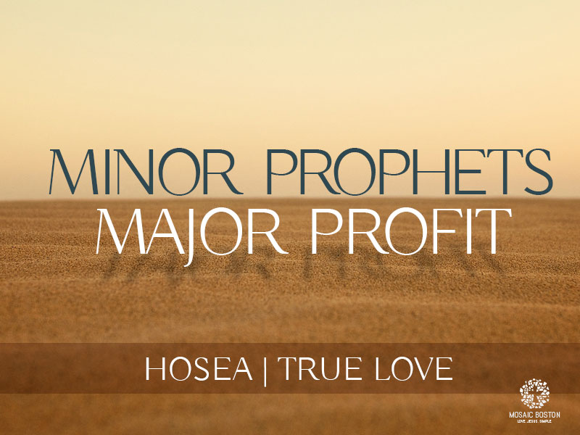
Minor Prophets—Major Profit
Big Issues in the Little Books

Slide 9
Slides on
Amos 1

Slide 10
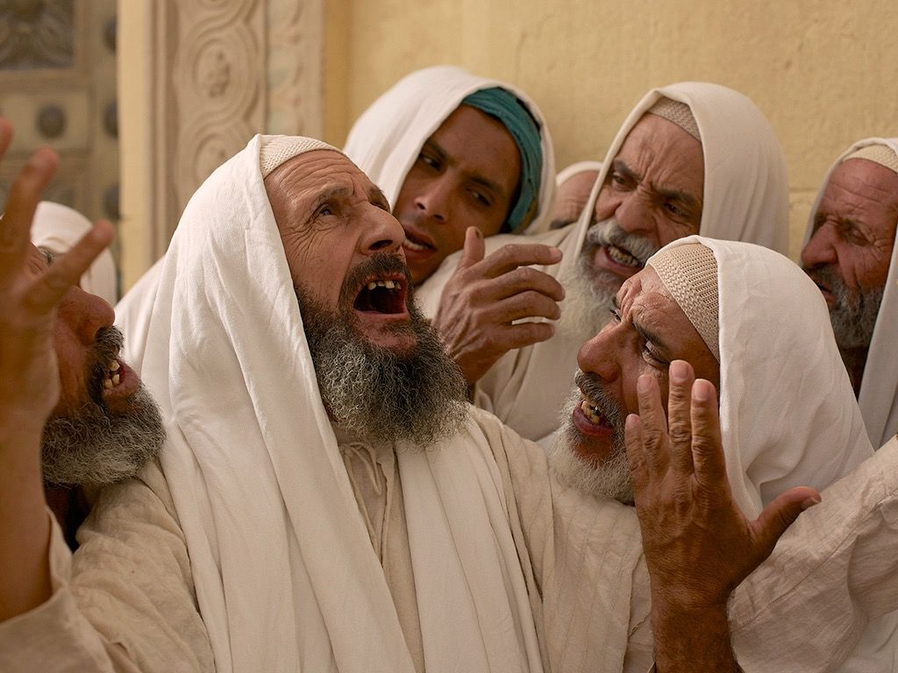
The Prophet Amos
"The words of Amos, one of the shepherds of Tekoa—what he saw concerning Israel two years before the earthquake, when Uzziah was king of Judah and Jeroboam son of Jehoash was king of Israel."
Amos 1:1 NIV

Slide 11
When Amos Wrote
584
Pekah
Hoshea
Main Final
Kings of Israel
Jeroboam II
Kings of Judah
Uzziah
Jotham
Ahaz
Hezekiah
Amos
(767-753 BC)
Notes:
11

Slide 12
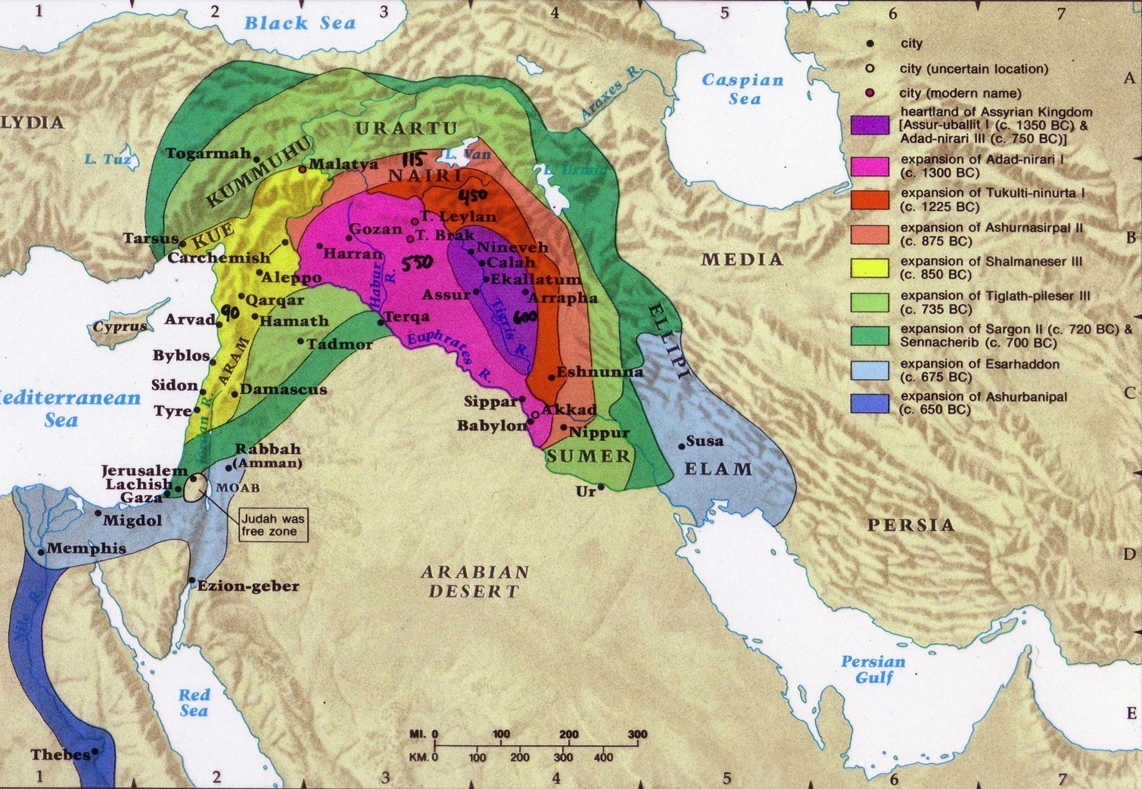
Assyrian Expansion
607

Slide 13
The Setting: Assyrian Might
443
Strong 883-783
Strong 745-626
Weak 790-745
900
850
800
750
70 0
65 0
600
550
500
Jonah & Amos

Slide 14
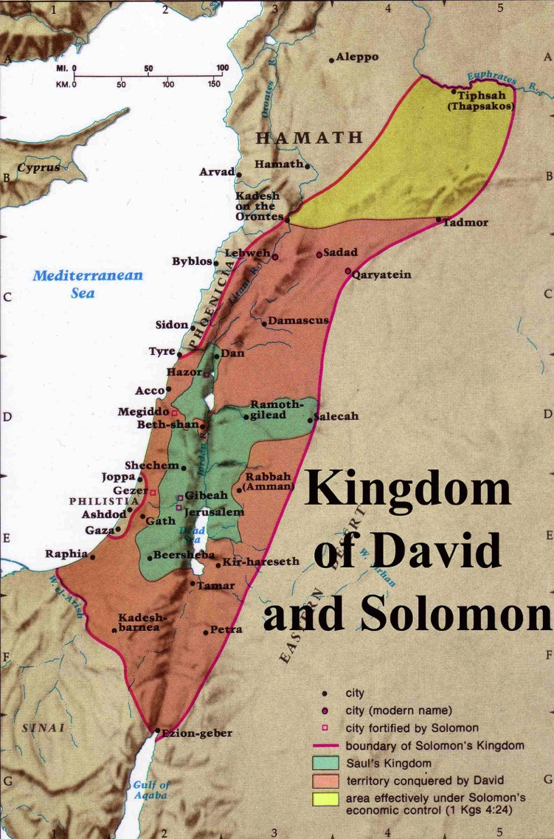
Expansion under Jeroboam II
446
Jeroboam II
"Jeroboam II recovered the territories of Israel between Lebo-hamath and the Dead Sea,* just as the Lord, the God of Israel, had promised through Jonah son of Amittai, the prophet from Gath-hepher."
(2 Kings 14:25 NLT).
* Hebrew the sea of the Arabah
Jeroboam I (930 BC)
Kingdom of Saul
Kingdom of David
Notes:
The boundaries under Jeroboam II went even farther than David and Solomon, who only had tribute sent from Hamath.

Slide 15
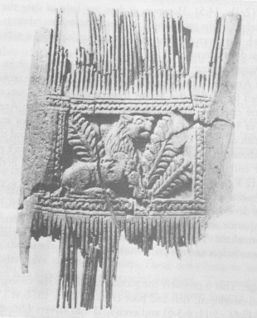
Ivory comb from time of Amos

Slide 16
Perils of Prosperity
592
 | Jonah | Amos | Hosea
Responsibility Addressed | Evangelistic | Social | Spiritual
Israel's Problem | Myopia | Injustice | Adultery
God's Attribute | Compassion | Justice | Faithfulness
Key Word | Compassion | Injustice | Loyal
Summary | God cares even for cruel Gentiles, so you should too! | God is fair with you, so you should be fair with others! | God keeps His covenant with you, so be faithful to Him as well!
Modern Parallels | Failure in Mission Responsibility | Oppression of Maids & Foreign Workers | Church's God is Modernity (Methods)
Date of Ministry (approx.) | 785-758 Beginning of Jeroboam's Reign | 767-753 Middle of Jeroboam's Reign | 755-710 End of Jeroboam's Reign
Notes:
Same slide in Jonah, Amos, & Hosea

Slide 17
Placing the Prophets
342
Placing the Prophets
Key Dates
931
Obadiah
722
Jonah
Amos
586

Slide 18
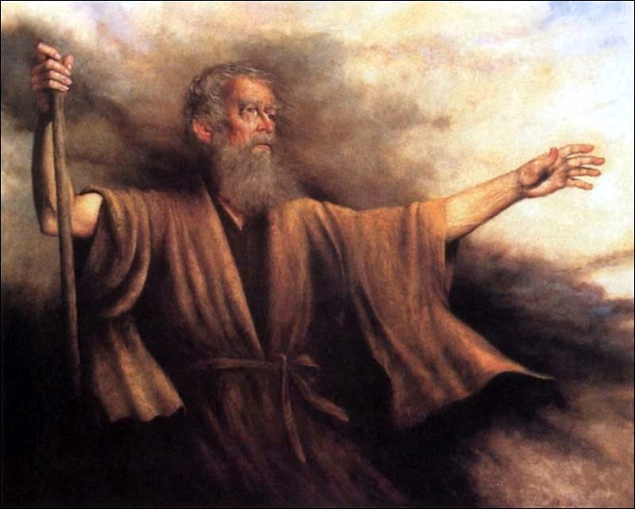
Authorship and Date
584
Amos not known outside of his writings
Native of Tekoa
Shepherd (1:1) or possibly businessman
Fig farmer (7:14)
Lived during the prosperous reigns of Uzziah, king of Judah (779-740 BC) and Jeroboam II, king of Samaria (783-743 BC)

Slide 19
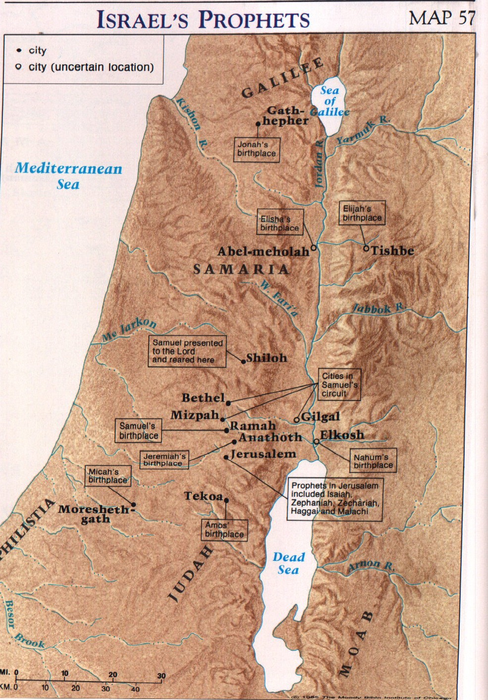
Where is Tekoa?
584

Slide 20
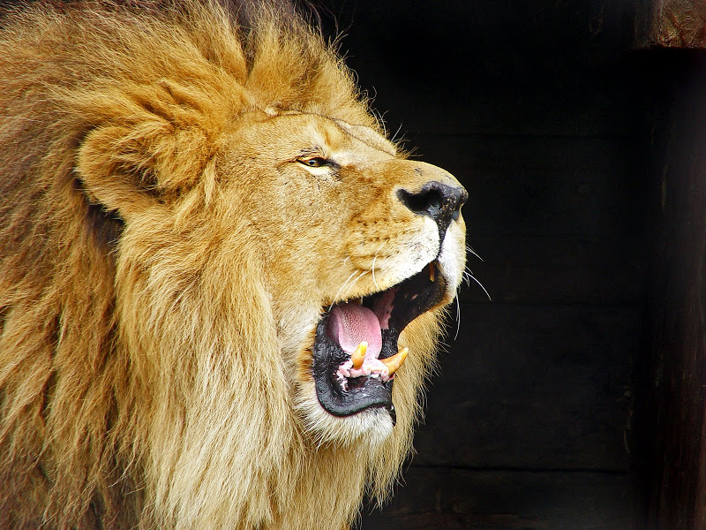
God's View of Injustice
583
"The LORD roars from Zion
and thunders from Jerusalem;
the pastures of the shepherds dry up,
and the top of Carmel withers."
Amos 1:2 NIV

Slide 21


Historical Background
584
A Hebrew prophet's ministry and message were intimately bound up with the conditions in which the people to whom he preached lived, and Amos' book is no exception.
Israel under Jeroboam II had economic prosperity
But they abused the peasant class
Social conditions in Samaria affected religious habits

Slide 22
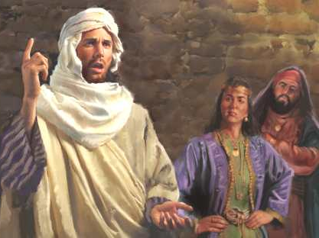
Amos
The first prophet to preach Israel's captivity

Slide 23
Characteristics
585
The most negative of the prophets with only 8 positive verses (9:8-15)
Blunt businessman-like language
First prophet to condemn not only Israel and Judah, but also the surrounding nations
The object of intense study (60 different commentaries)

Slide 24
How does God respond to injustice?
Two ways...

Slide 25
Placing the Prophets
342
Placing the Prophets
Key Dates
931
Obadiah
1:1–9:7
722
Jonah
Amos
PAST
9:8-15
586
FUTURE
Notes:
Preview: Today we will see two ways God deals with this inequity. From our view, the first way is past and the second way is yet future.
Text: The book of Amos reveals the way God dealt with injustice in the 700s BC in Amos 1:1–9:7 and the way he will address injustice in the future, addressed in Amos 9:8-15.

Slide 26
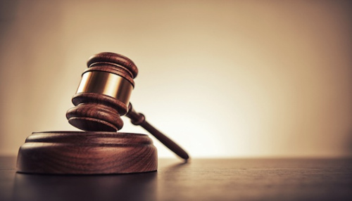
I. God judged injustice in Israel (Amos 1:1–9:7).
Notes:
The LORD warned the northern nation of exile that happened 40 years later.

Slide 27
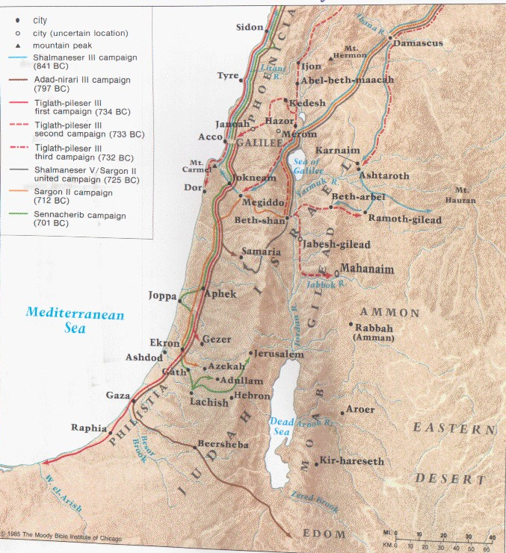
Judgment Against the Nations
(Amos 1-2)
591

Slide 28

Judgment Against the Nations
(Amos 1–2)
591
Asher
Naphtali
Amos declared the sins and penalties of Israel and 7 surrounding countries for their sins against God's people, Israel
Zebulun
Manasseh
Issachar
Manasseh
Gad
Ephraim
Dan
Benjamin
Reuben
Judah
Simeon
Notes:
Amos declared the sins and penalties of Israel and 7 surrounding countries for their sins against God's people, Israel
______
Common Slides Arabic-245
BE-30-Amos-28
OS-26-Ezek1-39-slide 162
OS-30-Amos-68

Slide 29

God will Judge Damascus
591
Damascus
Phoenicia
Amos 1:3-4 NLT
Syria
"This is what the LORD says:
'The people of Damascus have sinned again and again,
and I will not let them go unpunished!
They beat down my people in Gilead
as grain is threshed with iron sledges.
⁴So I will send down fire on King Hazael's palace,
and the fortresses of King Ben-hadad will be destroyed.'"
Gilead
Israel
Ammon
Philistia
Judah
Moab
Edom

Slide 30
God will Judge Philistia
591
Phoenicia
Amos 1:6-7 NIV
Syria
"This is what the LORD says:
'For three sins of Gaza,
even for four, I will not turn back [my wrath].
Because she took captive whole communities
and sold them to Edom,
⁷I will send fire upon the walls of Gaza that will consume her fortresses.'"
Israel
Ammon
Philistia
Judah
Gaza
Moab
Edom

Slide 31
God will Judge Phoenicia
591
Tyre
Phoenicia
Amos 1:9-10 NIV
Syria
"This is what the LORD says:
'For three sins of Tyre,
even for four, I will not turn back [my wrath].
Because she sold whole communities of captives to Edom, disregarding a treaty of brotherhood, ¹⁰I will send fire upon the walls of Tyre that will consume her fortresses."
Israel
Ammon
Philistia
Judah
Moab
Edom

Slide 32
God will Judge Edom
591
Phoenicia
Amos 1:11-12 NIV
Syria
"This is what the LORD says:
'The people of Edom have sinned again and again, and I will not let them go unpunished! They chased down their relatives, the Israelites, with swords, showing them no mercy. In their rage, they slashed them continually and were unrelenting in their anger.
¹²So I will send down fire on Teman, and the fortresses of Bozrah will be destroyed.'"
Israel
Ammon
Philistia
Judah
Moab
Edom

Slide 33
God will Judge Ammon
591
Phoenicia
Amos 1:13-15 NIV
Syria
"This is what the LORD says:
'The people of Ammon have sinned again and again, and I will not let them go unpunished! When they attacked Gilead to extend their borders, they ripped open pregnant women with their swords.
¹⁴So I will send down fire on the walls of Rabbah, and all its fortresses will be destroyed. The battle will come upon them with shouts, like a whirlwind in a mighty storm. ¹⁵And their king and his princes will go into exile together,'
says the LORD."
Gilead
Israel
Ammon
Philistia
Judah
Moab
Edom

Slide 34
Slides on
Amos 2

Slide 35
God will Judge Moab
591
Phoenicia
Amos 2:1-2 NIV
Syria
"This is what the LORD says: 'The people of Moab have sinned again and again, and I will not let them go unpunished! They desecrated the bones of Edom's king, burning them to ashes. ²So I will send down fire on the land of Moab, and all the fortresses in Kerioth will be destroyed. The people will fall in the noise of battle, as the warriors shout and the ram's horn sounds.
³ And I will destroy their king and slaughter all their princes,' says the LORD."
Israel
Ammon
Philistia
Judah
Moab
Edom

Slide 36
God will Judge Judah
591
Phoenicia
Amos 2:4-5 NIV
Syria
"This is what the LORD says: 'The people of Judah have sinned again and again, and I will not let them go unpunished! They have rejected the instruction of the LORD, refusing to obey his decrees. They have been led astray by the same lies that deceived their ancestors.
⁵So I will send down fire on Judah, and all the fortresses of Jerusalem will be destroyed.'"
Israel
Ammon
Philistia
Judah
Moab
Edom

Slide 37
God will Judge Israel
591
Phoenicia
Amos 2:6-7 NIV
Syria
"This is what the LORD says:
'For three sins of Israel, even for four, I will not turn back [my wrath]. They sell the righteous for silver, and the needy for a pair of sandals. ⁷They trample on the heads of the poor as upon the dust of the ground
and deny justice to the oppressed. Father and son use the same girl and so profane my holy name.'"
Israel
Ammon
Philistia
Judah
Moab
Edom

Slide 38
God will Judge Israel
591
Phoenicia
Amos 2:8-9 NIV
Syria
"They lie down beside every altar on garments taken in pledge. In the house of their god they drink wine taken as fines. ⁹I destroyed the Amorite before them, though he was tall as the cedars and strong as the oaks. I destroyed his fruit above and his roots below.'"
Israel
Ammon
Philistia
Judah
Moab
Edom

Slide 39
Book Chart
Amos
583
Judgment for Social Injustice
Eight Judgments |  | Three Sermons | Five Visions | Promise of Restoration
Chapters 1–2 |  | Chapters 3–6 | 7:1–9:7 | 9:8-15
"This is what the LORD says…" (1:3, 6, 9, 11, 13; 2:1, 4) |  | "Hear this word…" (3:1; 4:1; 5:1) | "This is what the Sovereign LORD showed me…" (7:1, 4, 7; 8:1) | "In that day…" "The days are coming…" (9:11, 13)
God's Impartiality |  | God's Justice | God's Judgments | God's Grace
Pronouncements of Judgment |  | Provocations of Judgment | Future of Judgment | Promises after Judgment
Judgment |  |  |  | Renewal
Horror |  |  |  | Hope
Neighbor Nations | Northern Nation
767-753 BC (before the fall of Samaria)

Slide 40
Slides on
Amos 3

Slide 41

Book Chart
Are we listening to God?
583

Slide 42
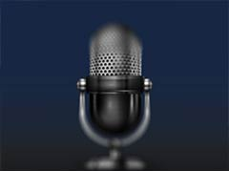
Three Sermons (Amos 3–6)
"Hear this word…"
(3:1)
"Hear this word…"
(4:1)
"Hear this word…"
(5:1)
Three structural markers to start each sermon
= "Listen!" • "Listen!" • "Listen!"

Slide 43
Listen more, Speak less

Slide 44
"Listen"
Tīng

Slide 45
King

Slide 46
Ear

Slide 47
Eye

Slide 48
One

Slide 49
Heart

Slide 50
Christ

Slide 51
"Listen"
Christ
Ear
Eye
One
King
Tīng
Heart
Notes:
The Chinese character of "listen" means to give one (undivided attention) to Christ the king with your eyes, ears, mind (king), and heart.

Slide 52
Three Sermons (Amos 3–6)
"Hear this word…"
(3:1)
"Hear this word…"
(4:1)
"Hear this word…"
(5:1)
"They do not know how to do right"
(3:10)

Slide 53
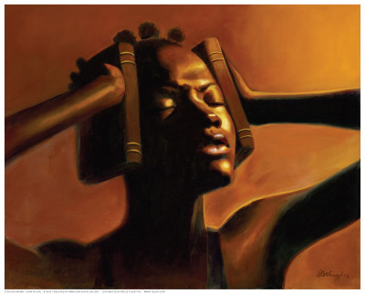
Book Chart
Are we listening to God?
583

Slide 54
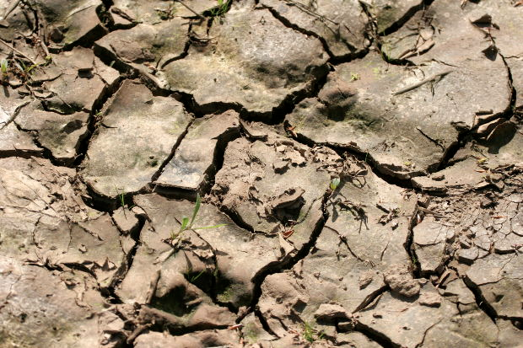
Book Chart
When we don't listen, it is as if there is a famine for God's Word.
583

Slide 55
Slides on
Amos 4

Slide 56
Three Sermons (Amos 3–6)
"Hear this word…"
(3:1)
"Hear this word…"
(4:1)
"Hear this word…"
(5:1)
"They do not know how to do right"
(3:10)
"You oppress the poor and crush the needy"(4:1)

Slide 57
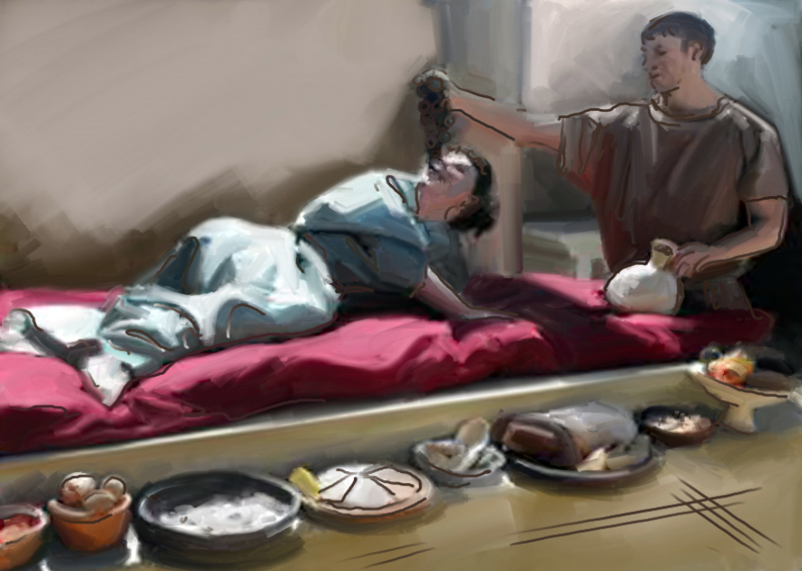
"Listen to me, you fat cows living in Samaria, you women who oppress the poor and crush the needy, and who are always calling to your husbands,
'Bring us another drink!'"
(Amos 4:1 NLT).

Slide 58
Ivory Comb
Ivory comb from Megiddo, representative of the wealth and luxury assailed by Amos (3:15; 6:4)
—Oriental Institute, University of Chicago

Slide 59
Slides on
Amos 5

Slide 60
Three Sermons (Amos 3–6)
"Hear this word…"
(3:1)
"Hear this word…"
(4:1)
"Hear this word…"
(5:1)
"They do not know how to do right"
(3:10)
"You oppress the poor and crush the needy"(4:1)
"I hate, I despise your religious feasts"
(5:21)

Slide 61

Sins of Injustice
585
5:10 How you hate honest judges!
How you despise people who tell the truth!
5:11 You trample the poor,
stealing their grain through taxes and unfair rent.
Therefore, though you build beautiful stone houses, you will never live in them.
Though you plant lush vineyards,
you will never drink wine from them.
––NLT

Slide 62
Sins of Injustice
585
5:12 For I know the vast number of your sins
and the depth of your rebellions.
You oppress good people by taking bribes
and deprive the poor of justice in the courts.
5:13 So those who are smart keep their mouths shut, for it is an evil time.
––NLT

Slide 63
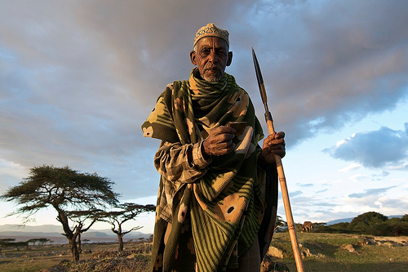
Amos
Blunt & Brazen

Slide 64
Slides on
Amos 6

Slide 65
Sins of Injustice
585
6:4 How terrible for you who sprawl on ivory beds and lounge on your couches, eating the meat of tender lambs from the flock and of choice calves fattened in the stall.
6:5 You sing trivial songs to the sound of the harp and fancy yourselves to be great musicians like David.
6:6 You drink wine by the bowlful
and perfume yourselves with fragrant lotions.
You care nothing about the ruin of your nation.
6:7 Therefore, you will be the first to be led away as captives. Suddenly, all your parties will end.
––NLT

Slide 66
Slides on
Amos 7

Slide 67
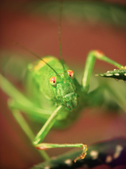
The Locust Vision—Amos 7:1-3
585
"The Sovereign LORD showed me a vision. I saw him preparing to send a vast swarm of locusts over the land. This was after the king’s share had been harvested from the fields and as the main crop was coming up. ²In my vision the locusts ate every green plant in sight. Then I said, “O Sovereign Lord, please forgive us or we will not survive, for Israel is so small.' ³So the LORD relented from this plan. 'I will not do it,' he said" (NLT).
Notes:
God would strip the land bare—but not fully in fulfillment of His Covenant.

Slide 68
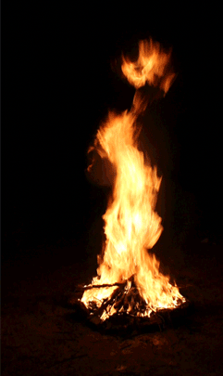
The Fire Vision—Amos 7:4-6
585
"Then the Sovereign LORD showed me another vision. I saw him preparing to punish his people with a great fire. The fire had burned up the depths of the sea and was devouring the entire land. ⁵Then I said, 'O Sovereign LORD, please stop or we will not survive, for Israel is so small.' ⁶Then the LORD relented from this plan, too. 'I will not do that either,' said the Sovereign LORD. ³So the LORD relented from this plan. 'I will not do it,' he said" (NLT).
Notes:
God would burn the entire nation, but not completely in fulfillment of His Covenant.

Slide 69

The Plumb Line Vision—Amos 7:7-8
585
"This is what he showed me: The LORD was standing by a wall that had been built true to plumb, with a plumb line in his hand. ⁸And the LORD asked me, 'What do you see, Amos?'
'A plumb line,' I replied.
Then the LORD said, "Look, I am setting a plumb line among my people Israel; I will spare them no longer" (NLT).
Notes:
Israel is morally crooked compared to God’s absolute standards, so He will destroy the people and the altars.

Slide 70
Slides on
Amos 8

Slide 71

The Ripe Fruit Vision—Amos 8:1-3
585
"Then the Sovereign LORD showed me another vision. In it I saw a basket filled with ripe fruit. ²'What do you see, Amos?' he asked. I replied, 'A basket full of ripe fruit.' Then the LORD said, 'Like this fruit, Israel is ripe for punishment! I will not delay their punishment again. ³In that day the singing in the Temple will turn to wailing. Dead bodies will be scattered everywhere. They will be carried out of the city in silence. I, the Sovereign LORD, have spoken!'" (NLT).
Notes:
Israel would soon end in judgment for disregarding social and religious duties.

Slide 72
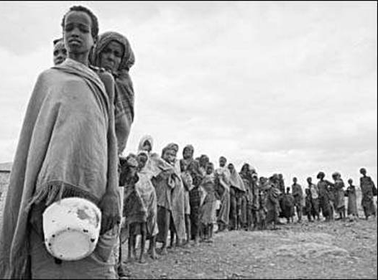
Amos 8:11-13 NLT
593
"The time is surely coming," says the Sovereign LORD, "when I will send a famine on the land—
not a famine of bread or water

Slide 73
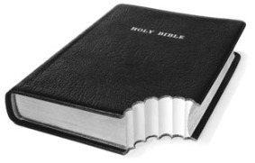

Amos 8:11-13 NLT
593
"The time is surely coming," says the Sovereign LORD, "when I will send a famine on the land—
not a famine of bread or water but of hearing the words of the LORD.
¹²People will stagger from sea to sea and wander from border to border searching for the word of the LORD, but they will not find it.
¹³Beautiful girls and strong young men will grow faint in that day,
thirsting for the LORD's word."

Slide 74
Slides on
Amos 9

Slide 75
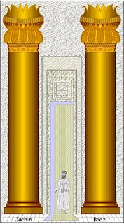
The Smashed Pillars Vision
—Amos 9:1
585
"Then I saw a vision of the LORD standing beside the altar. He said, 'Strike the tops of the Temple columns, so that the foundation will shake. Bring down the roof on the heads of the people below. I will kill with the sword those who survive. No one will escape!" (NLT).
Notes:
God will destroy Israel's religious system as He did any other disobedient land

Slide 76
I. God judged injustice in Israel (Amos 1:1–9:7).

Slide 77

II. God will restore Israel to fulfill his promises (Amos 9:8-15).

Slide 78
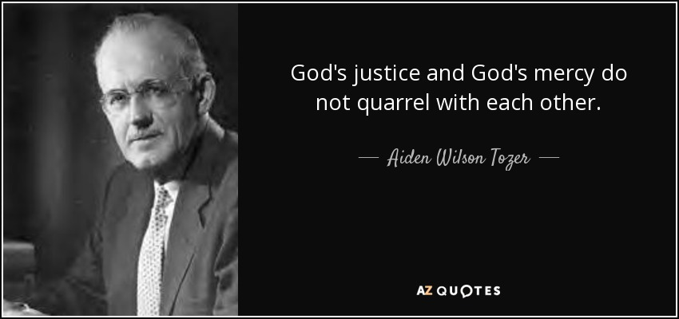
—A. W. Tozer—
God's justice and God's mercy do not quarrel with each other.

Slide 79
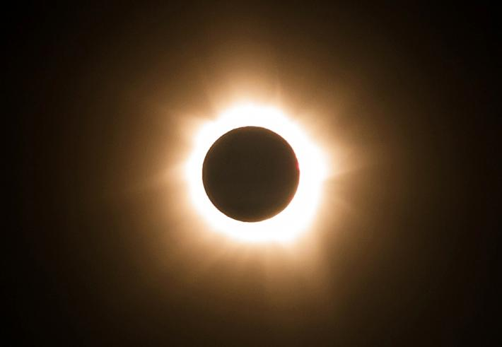
Amos
Finally, after the most judgment of any book in the Bible…

Slide 80
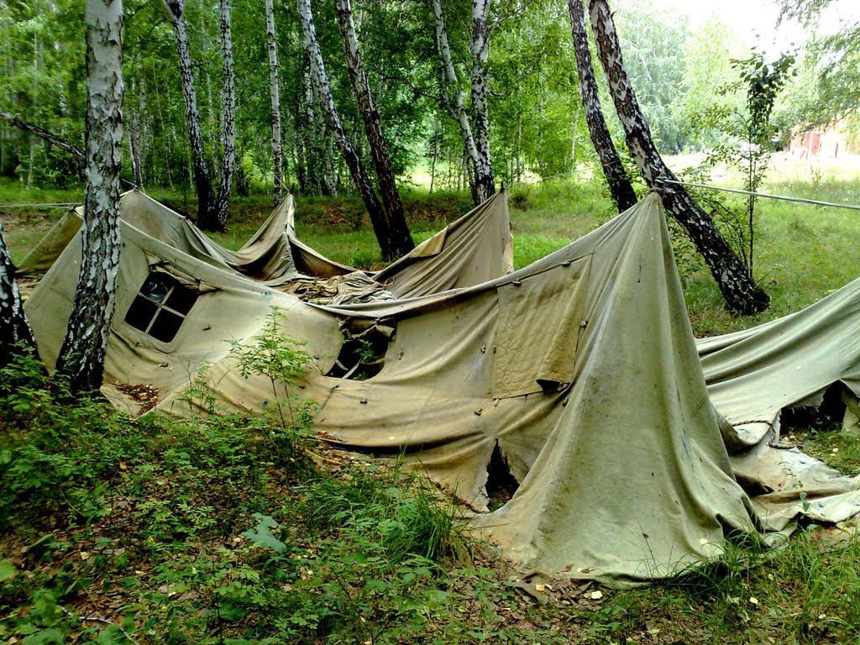
Can you restore a fallen tent?
593
God can.

Slide 81

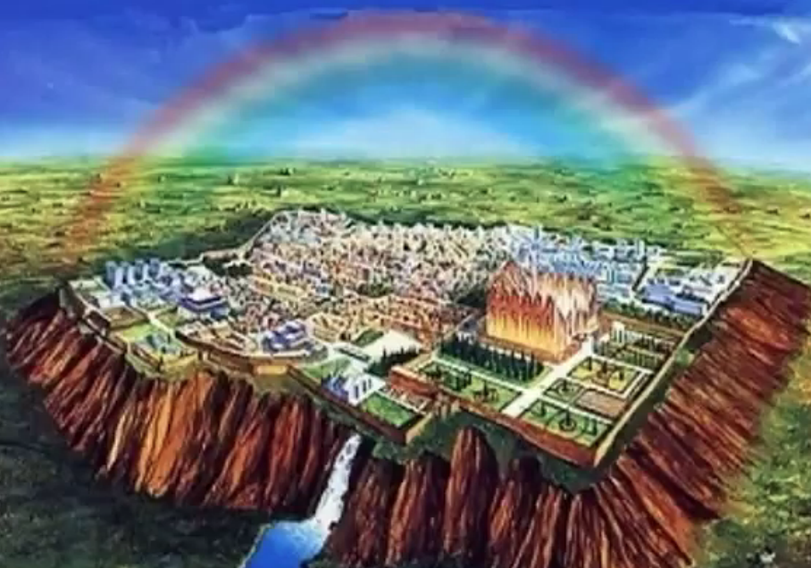
Amos 9:11 (NIV)
593
"'In that day I will restore David's fallen tent. I will repair its broken places, restore its ruins, and build it as it used to be."

Slide 82

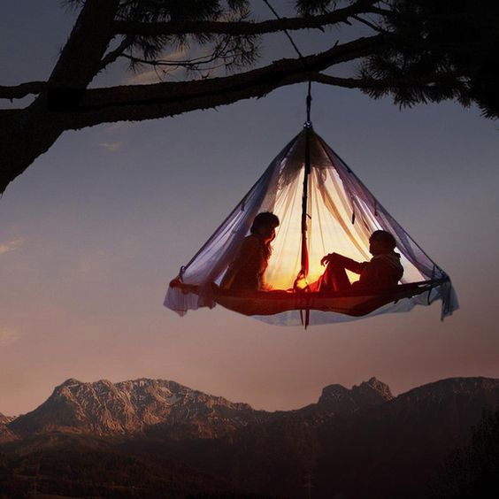
Amos 9:11 (NIV)
593
"In that day I will restore David's fallen tent.
I will repair its broken places, restore its ruins, and build it as it used to be."
Zedekiah Deposed
586 BC
Jesus
Rules
AD ??

Slide 83
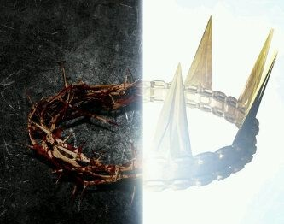
Amos
Christ's crown of thorns will be replaced with a crown of rule

Slide 84
Amos 9:11-12 (NIV)
593
"In that day I will restore David's fallen tent. I will repair its broken places, restore its ruins, and build it as it used to be, ¹²so that they may possess the remnant of Edom and all the nations that bear my name,' declares the LORD, who will do these things."
Judah
Edom

Slide 85
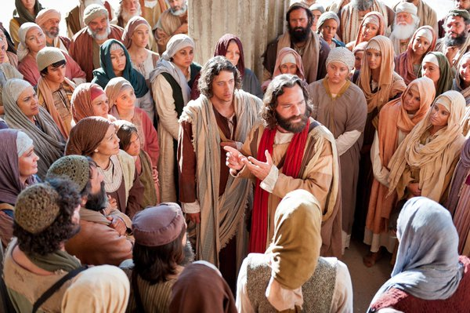
Peter Led 3000 to Christ at Pentecost
"Those who accepted his message were baptized, and about three thousand were added to their number that day."
Acts 2:41 NIV

Slide 86
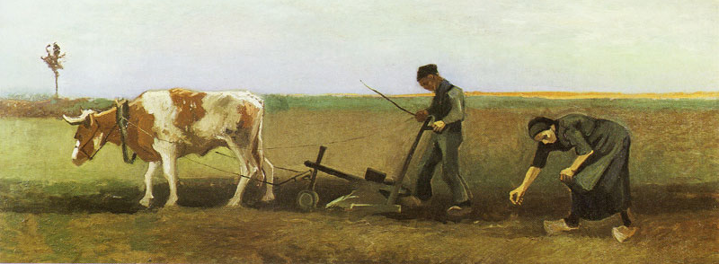
Amos 9:13a (NIV)
593
"'The days are coming,' declares the LORD, 'when the reaper will be overtaken by the plowman and the planter by the one treading grapes."

Slide 87
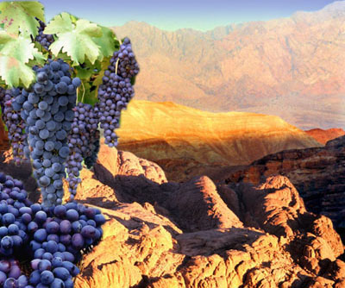
Amos 9:13b (NIV)
593
"New wine will drip from the mountains and flow from all the hills."

Slide 88
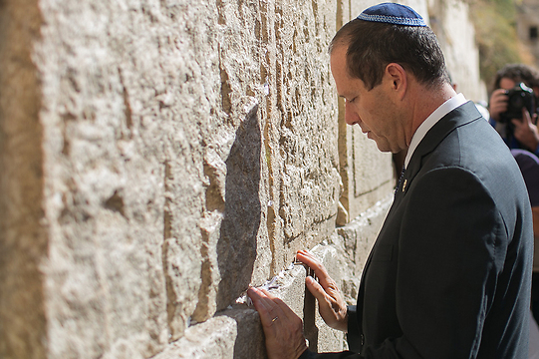
Amos 9:14-15 (NIV)
593
"'I will bring back my exiled people Israel;
they will rebuild the ruined cities and live in them. They will plant vineyards and drink their wine; they will make gardens and eat their fruit.
¹⁵I will plant Israel in their own land, never again to be uprooted from the land I have given them,' says the LORD your God."

Slide 89
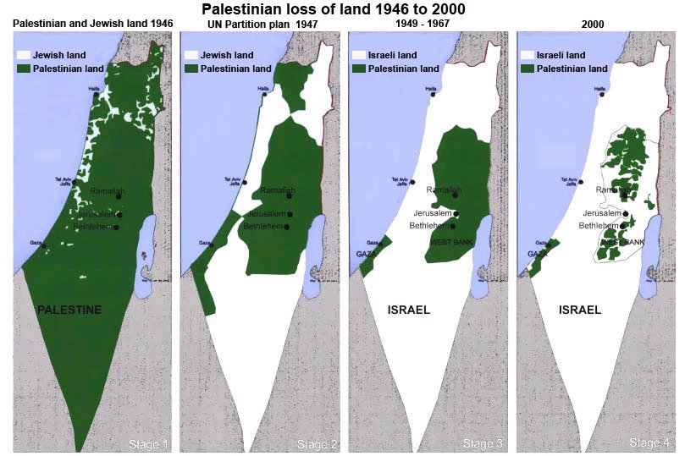
Israel's Increase of Land
593

Slide 90
How does God respond to injustice?
Two ways...

Slide 91

—Main Idea of Amos—
God is just
—past, present and future—
so we should be just too

Slide 92
I. God judged injustice in Israel (Amos 1:1–9:7).

Slide 93
II. God will restore Israel to fulfill his promises (Amos 9:8-15).

Slide 94
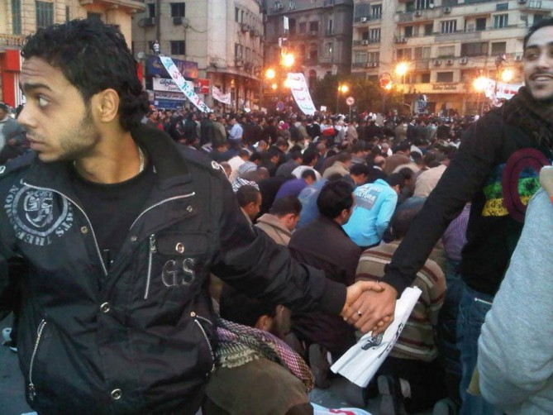
Christians Protect Muslims
583
343
How do we fight injustice?
Amos

Slide 95

—Love the Church—
We seek to make sure no member is in need—rent, oppressive work situation, etc.

Slide 96

Applications
583
  Prosperous Christians must not wink at social injustice:
  What social injustices do you see in your country?
  What responsibility does the church have to correct these wrongs?
  3. What is God telling you to do about a social inequity?

Slide 97
Black

Slide 98


OT Preaching link at BibleStudyDownloads.org
Get this presentation for free!
Notes:
OT Survey (os)

